Slide 1

WAY TO ENTERPRISE
Advanced Java
VTI ACADEMY
Author: duy.nguyenngoc1@vti.com.vn
March 2020

Slide 2
Agenda
Setup Spring tool suite
Copyright © VTI Academy All Rights Reserved

Slide 3
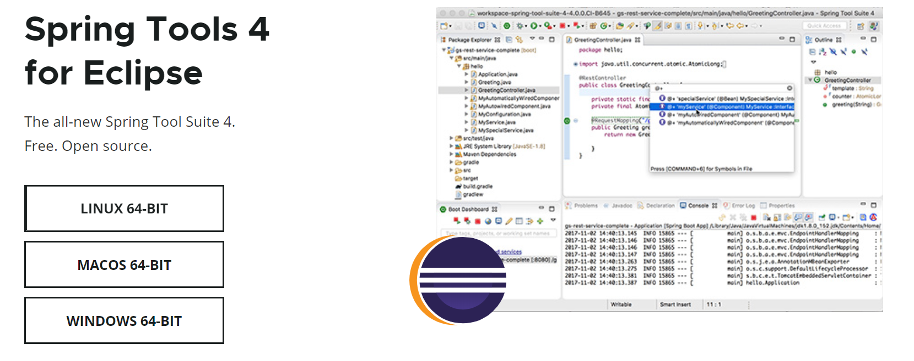
Setup Spring tool suite
Download https://spring.io/tools

Slide 4
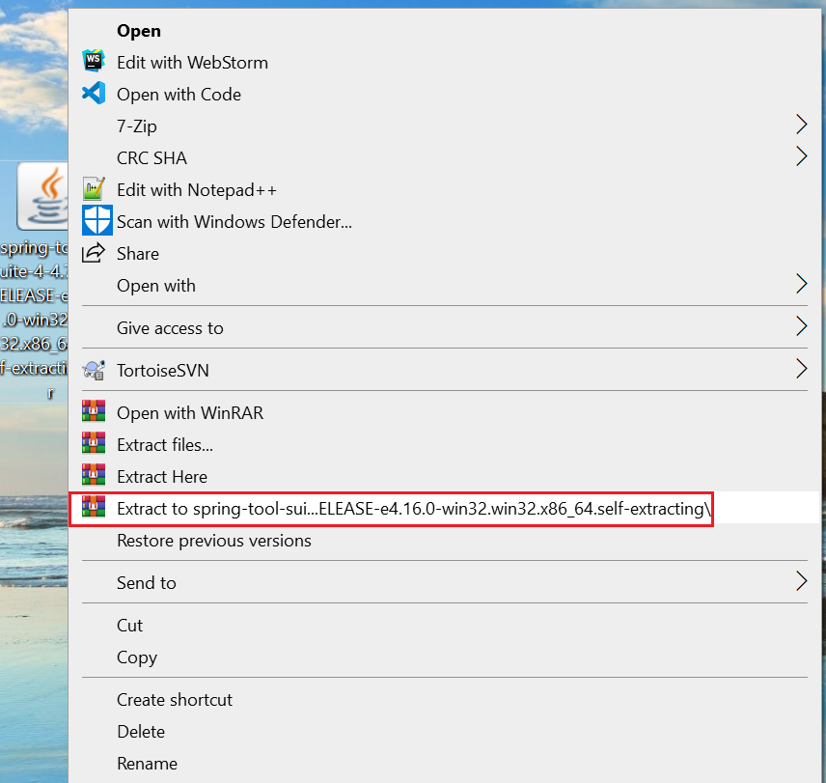
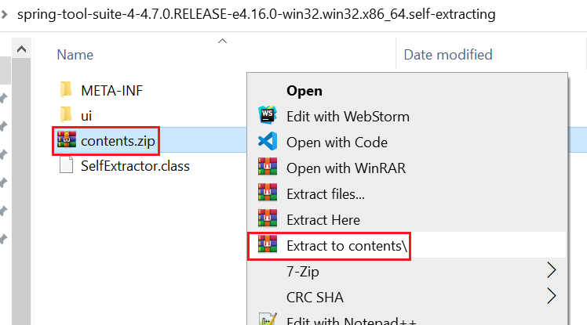
Setup Spring tool suite
Extract file

Slide 5
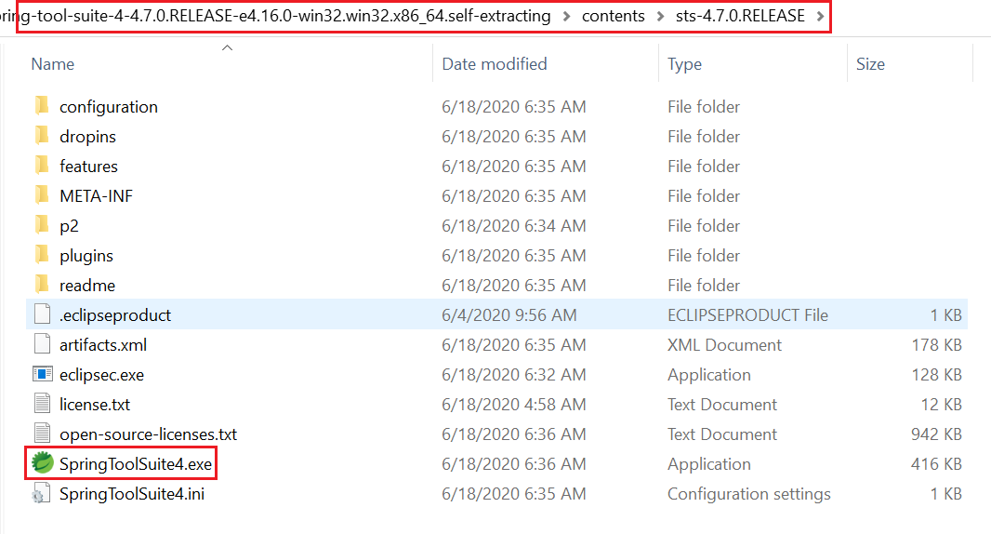
Setup Spring tool suite
Extract file

Slide 6

Setup Spring tool suite

Slide 7
Setup Spring tool suite
Tutorial https://www.youtube.com/watch?v=MrgIY7GslXQ

Slide 8
Q & A
Copyright © VTI Academy All Rights Reserved

